Slide 1
Hidden Trails Elementary ---- DLI curriculum
DLIP Kindergarten Team
5/15/2024

Slide 2
Agenda
--Benefits of Language Immersion
-- The big picture of Our Curriculum
-- Family Support Resources

Slide 3
1
IMMERSION PROGRAM

Slide 4
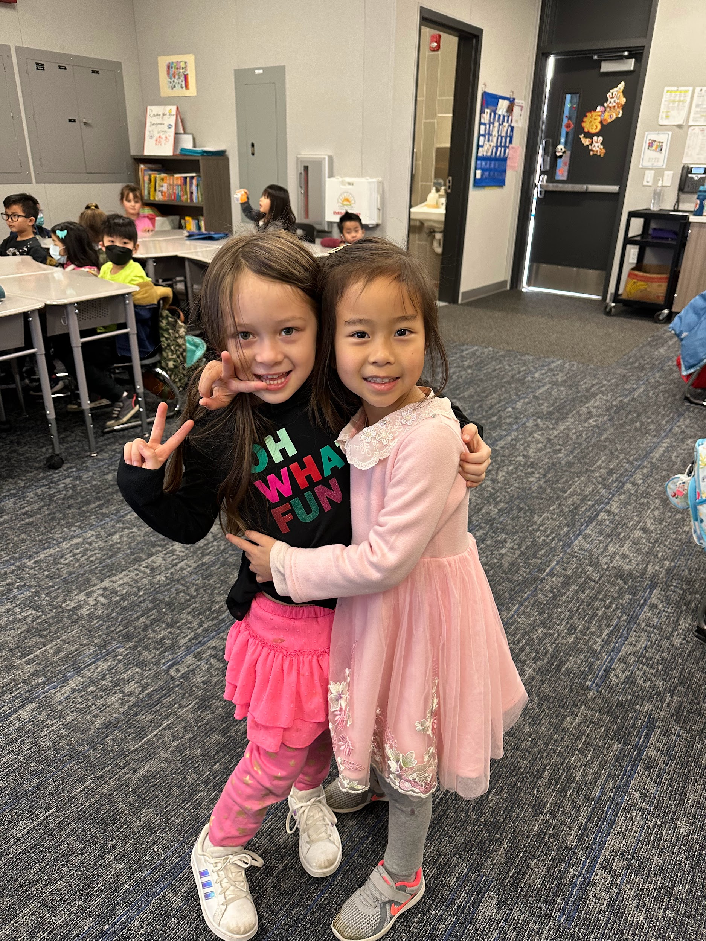
Benefits of Language Immersion
Biliterate skills give students the option for future careers utilizing their bilingual skills
Second-language study helps develop stronger thinking and reasoning skills which support the problem solving necessary for academic success
Notes:
zhao

Slide 5
Benefits of Language Immersion
Students who complete the immersion K-12 program will receive Seal of Biliteracy, Immersion Program Graduation Stole, CTE Pathway completion tassel, A-G language requirement exceeded and opportunities to take AP examinations for college course credit.
Notes:
zhao

Slide 6
The Goal of Dual Immersion Program
Notes:
zhang： The Language Immersion instructional model is relied upon for guidance, with flexibility afforded in response to student needs. K–12 participation in Language Immersion is beneficial to students as they graduate biliterate, bilingual, and with a wider understanding of different cultures and backgrounds, all which equip them to find success in their future academic and career endeavors. Maximize students’ second language proficiency. Provide a rich academic environment in both first and second languages. Develop students’ abilities to work successfully in multiple cultural settings.

Slide 7
2
Our Curriculum
Notes:
zhao

Slide 8
Why we use this Curriculum
The curriculum is based on the California Common Core State Standards.
The curriculum is based on the ACTFL Standards.
This curriculum prepares our students to achieve on district-developed assessments.
This curriculum is customized to our school.
Notes:
zhao

Slide 9
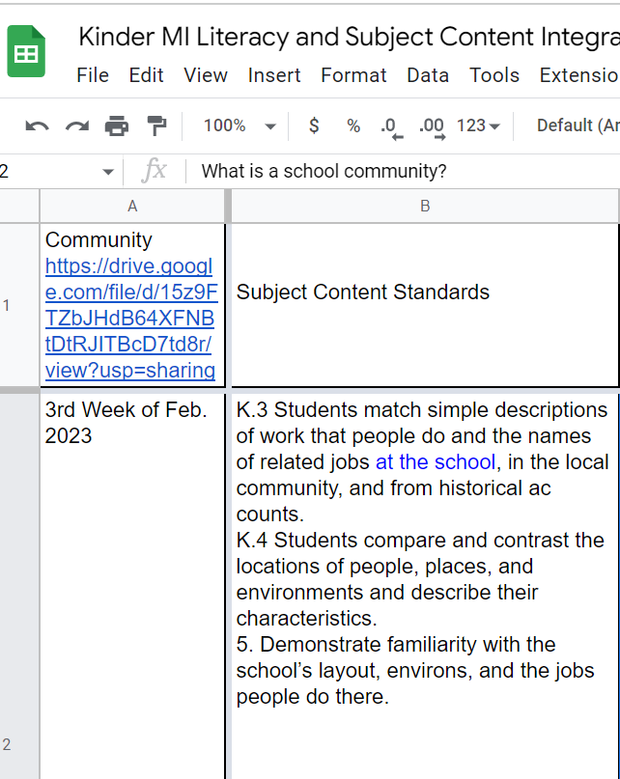
The curriculum is based on the California Common Core State Standards.
Notes:
zhao

Slide 10
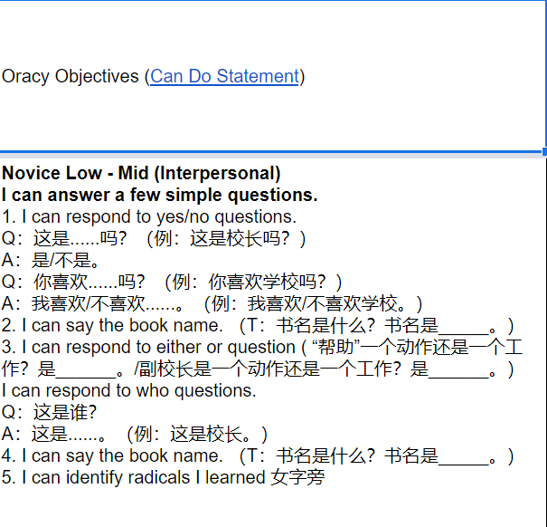
The curriculum is based on the ACTFL Standards.
Notes:
zhao

Slide 11
This curriculum prepares our students to achieve on district-developed assessments.
Notes:
zhao

Slide 12
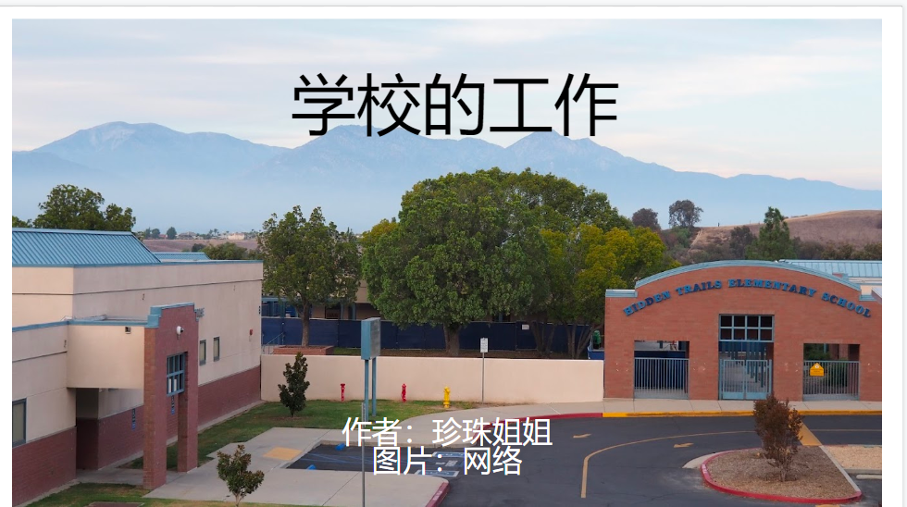
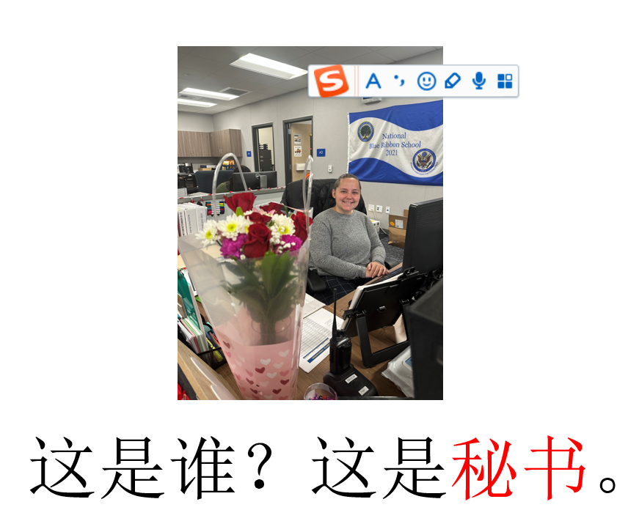
This curriculum is customized to our school.
Notes:
zhao

Slide 13
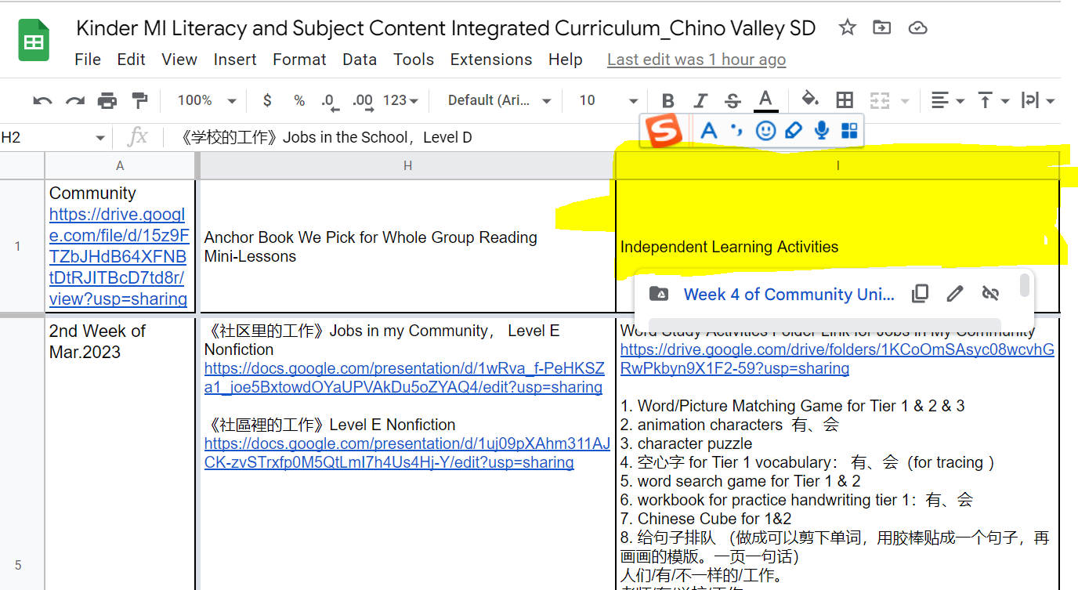
Notes:
zhang

Slide 14
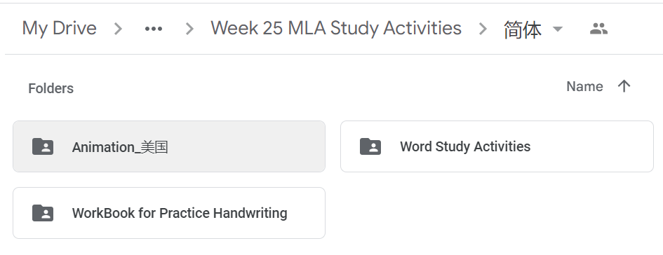
Notes:
zhang

Slide 15
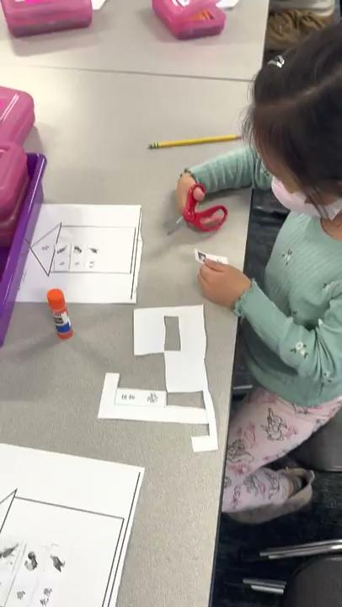
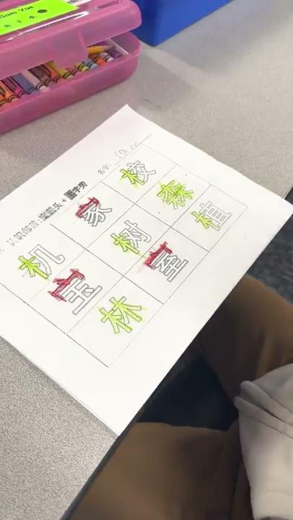
Word Study Activity
Notes:
zhang

Slide 16
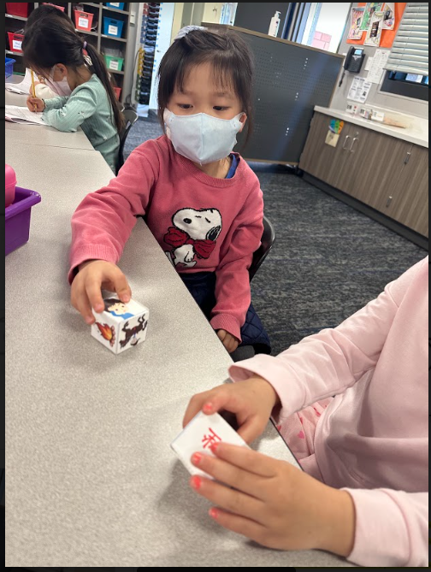
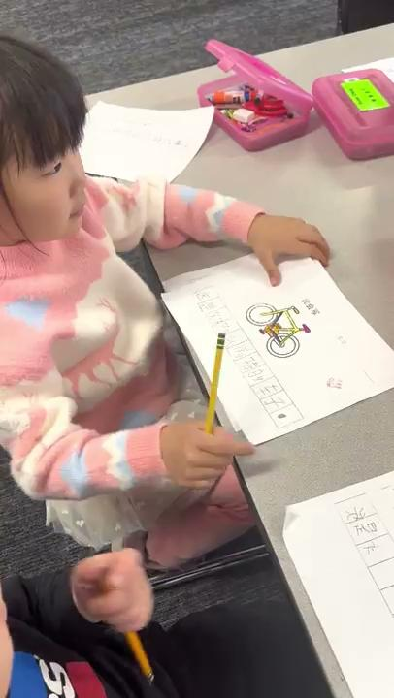
Notes:
zhang

Slide 17
3
Family Support Resources
Notes:
zhao

Slide 18
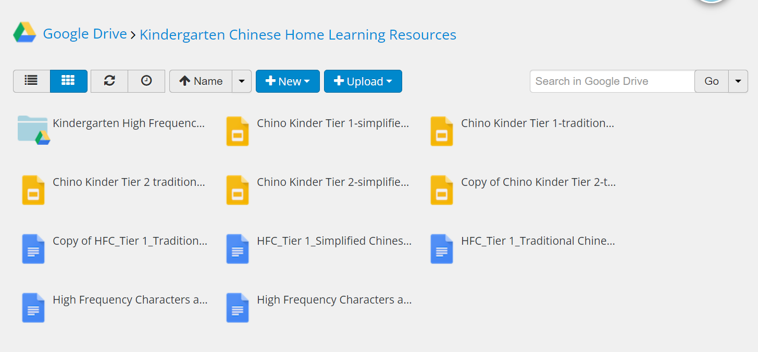
Notes:
zhang

Slide 19
Fun Club
Fun Club is currently full based on their staffing. They are trying to hire more teachers to accommodate more students but there are no guarantees. There are local companies that provide child care and pick-up from Hidden Trails.

Slide 20
How will I know if my child is in an AM or PM session of kindergarten?
You will receive a postcard in the mail in July. If you have not received in by July 19th, please contact the school.

Slide 21
Important Dates
August 2nd, Teacher Meet and Greet
August 5th, First Day of School
August 21st, Back to School Night

Slide 22
Thank you

